Slide 1
Getting Started
(1) Copy to your hard disk from a USB Key or DVD:
Copy needed files (VirtualBox, terminal, possibly an X server) for your platform (Win/Mac/Linux)
Copy Java 6 and Eclipse for your platform, if you want to use Java
Copy VM image: OpenFlowTutorial-101311.zip
Pass on the DVD or USB key to someone else!
(2) Unzip OpenFlowTutorial-101311.zip
(3) Point browser to instructions:
http://www.openflow.org/wk/index.php/OpenFlow_Tutorial (note the underscore)
You should NOT need to download any large files – spare the WiFi!

Slide 2
OpenFlow Hands-on Tutorial part of the the Open Networking Summit Li Ka Shing Center Stanford University Oct 17, 2011
Brandon Heller
Stanford University
with help from all the people
listed on the next few pages

Slide 3
This tutorial wouldn’t be possible without:
OpenFlow Experts
Glen Gibb
Nicholas Bastin
Ali Al-Shabibi
Tatsuya Yabe
Masayoshi Kobayashi
Yiannis Yiakoumis
Ali Yahya
Te-Yuan Huang
Bob Lantz
David Erickson

Slide 4
This tutorial wouldn’t be possible without:
Deployment Forum Speakers
Subhasree Mandal (Google)
Johan van Reijendam (Stanford)
David Erickson (Stanford)
Videographer:
Yiannis Yiakoumis

Slide 5
This tutorial wouldn’t be possible without:
Past slides from:
Nick McKeown
Rob Sherwood
Guru Parulkar
Srini Seetharaman
Yiannis Yiakoumis
Guido Appenzeller
Masa Kobayashi, + others

Slide 6
Welcome

Slide 7
Getting Started
(1) Copy to your hard disk from a USB Key or DVD:
Copy needed files (VirtualBox, terminal, possibly an X server) for your platform (Win/Mac/Linux)
Copy Java 6 and Eclipse for your platform, if you want to use Java
Copy VM image: OpenFlowTutorial-101311.zip
Pass on the DVD or USB key to someone else!
(2) Unzip OpenFlowTutorial-101311.zip
(3) Point browser to instructions:
http://www.openflow.org/wk/index.php/OpenFlow_Tutorial (note the underscore)
You should NOT need to download any large files – spare the WiFi!

Slide 8
Agenda
Time | Description
9:30-10:45 | Introduction: Motivation, History, Interface
11:00-12:00 | What can you do with OpenFlow and SDN?
1:30-2:30 | SDN Building Blocks
2:45-4:00 | SDN Deployment Panel and Wrap-up
feel free to:
ask any kind of OpenFlow question during the hands-on
take breaks at any point during the hands-on
work during the 15-minute breaks, or lunch

Slide 9
Goals of this Tutorial
By the end, everyone should know:
what OpenFlow is
how it’s used and how you can use it
where it’s going
how OpenFlow relates to Software-Defined Networking (SDN)
Present a useful mix of hands-on and lecture-based content
Have fun
Notes:
What: protocol,

Slide 10
Why OpenFlow?

Slide 11
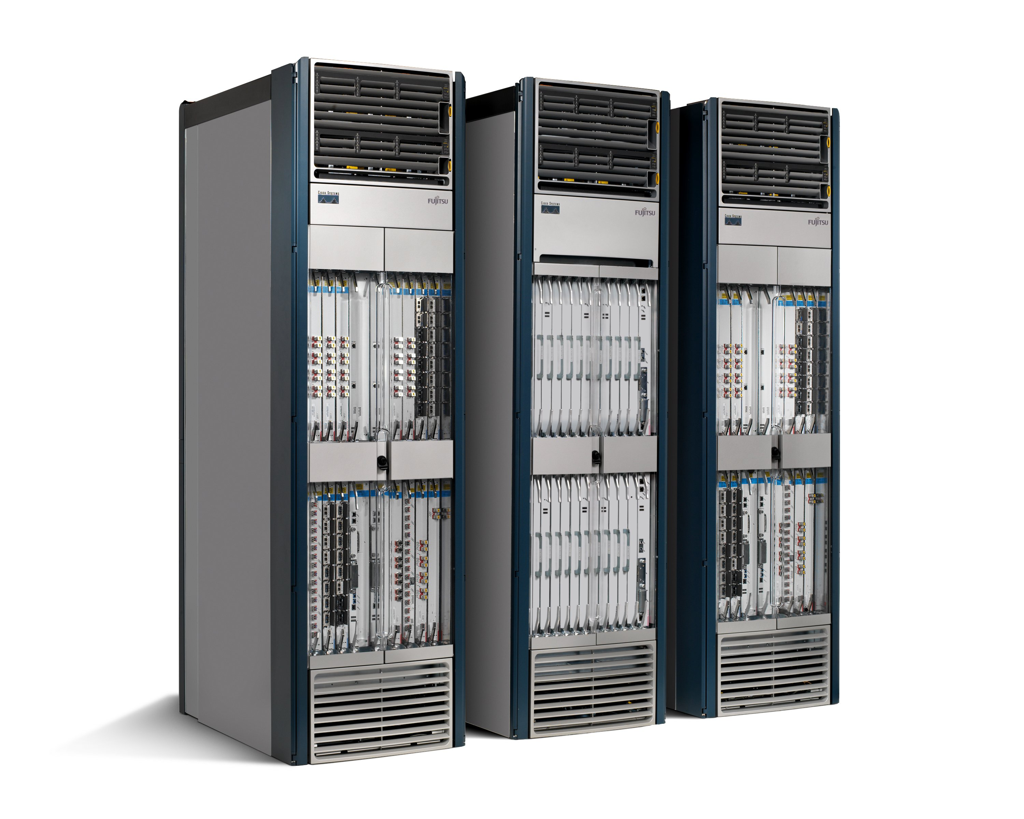

The Ossified Network
Routing, management, mobility management, access control, VPNs, …
Feature
Feature
Million of lines of source code
5400 RFCs
Barrier to entry
Operating
System
Specialized Packet Forwarding Hardware
Billions of gates
Bloated
Power Hungry
Many complex functions baked into the infrastructure
OSPF, BGP, multicast, differentiated services, Traffic Engineering, NAT, firewalls, MPLS, redundant layers, …
An industry with a “mainframe-mentality”, reluctant to change
11
Notes:
11

Slide 12
Research Stagnation
Lots of deployed innovation in other areas
OS: filesystems, schedulers, virtualization
DS: DHTs, CDNs, MapReduce
Compilers: JITs, vectorization
Networks are largely the same as years ago
Ethernet, IP, WiFi
Rate of change of the network seems slower in comparison
Need better tools and abstractions to demonstrate and deploy
Notes:
In these other areas, you can real systems on top of high-quality, open platforms, and you don’t need to reinvent the wheel

Slide 13
Closed Systems (Vendor Hardware)
Stuck with interfaces (CLI, SNMP, etc)
Hard to meaningfully collaborate
Vendors starting to open up, but not usefully

Slide 14
Open Systems
 | Performance Fidelity | Scale | Real User Traffic? | Complexity | Open
Simulation | medium | medium | no | medium | yes
Emulation | medium | low | no | medium | yes
Software Switches | poor | low | yes | medium | yes
NetFPGA | high | low | yes | high | yes
Network Processors | high | medium | yes | high | yes
Vendor Switches | high | high | yes | low | no
gap in the tool space
none have all the desired attributes!

Slide 15




Ethane, a precursor to OpenFlow Centralized, reactive, per-flow control
Controller
Flow Switch
Flow Switch
Flow Switch
Host B
Host A
Flow Switch
See Ethane SIGCOMM 2007 paper for details

Slide 16
OpenFlow: a pragmatic compromise
+ Speed, scale, fidelity of vendor hardware
+ Flexibility and control of software and simulation
Vendors don’t need to expose implementation
Leverages hardware inside most switches today (ACL tables)

Slide 17
It’s hard to add a feature to a network
It’s not just that we lack access to line-rate forwarding that we can control
Fully distributed algorithms are hard, especially when defined at the protocol level
Your protocol must implement its own mechanisms
Must work on constrained and heterogeneous resources
This is where Software-Defined Networking comes in. More to come later today.

Slide 18
How does OpenFlow work?

Slide 19
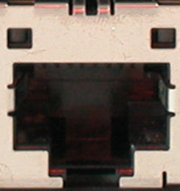
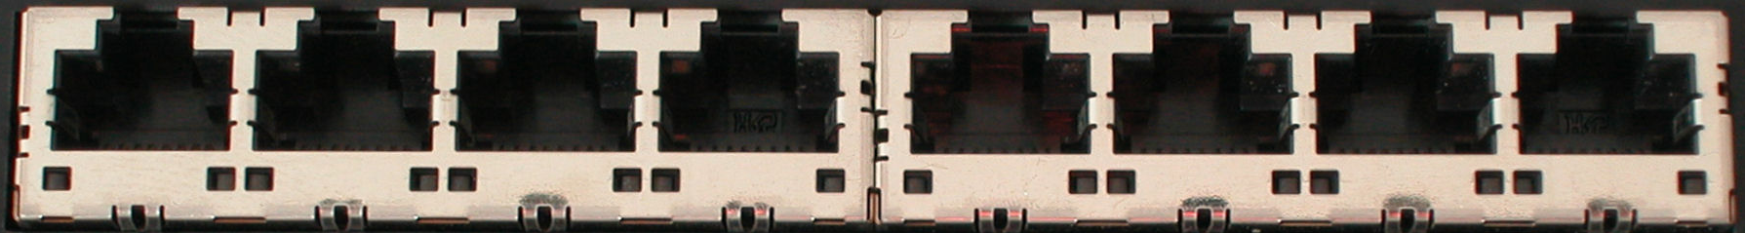
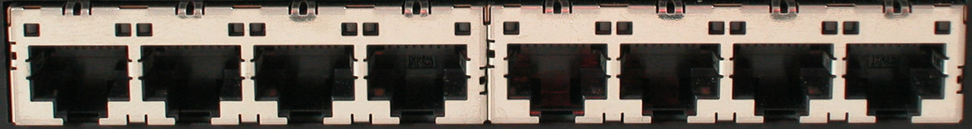
Ethernet Switch

Slide 20
Control Path
Control Path (Software)
Data Path (Hardware)

Slide 21
OpenFlow Controller
OpenFlow Protocol (SSL/TCP)
Control Path
OpenFlow
Data Path (Hardware)

Slide 22
OpenFlow Example
Controller
OpenFlow Client
PC
Software
Layer
Flow Table
MAC
src
MAC
dst
IP
Src
IP
Dst
TCP
sport
TCP
dport
Action
Hardware
Layer
*
*
*
5.6.7.8
*
*
port 1
port 1
port 2
port 3
port 4
5.6.7.8
1.2.3.4

Slide 23
OpenFlow Basics Flow Table Entries
Rule
Action
Stats
Packet + byte counters
Forward packet to zero or more ports
Encapsulate and forward to controller
Send to normal processing pipeline
Modify Fields
Any extensions you add!
Switch
Port
VLAN
ID
VLAN
pcp
MAC
src
MAC
dst
Eth
type
IP
Src
IP
Dst
IP
ToS
IP
Prot
L4
sport
L4
dport
+ mask what fields to match
Notes:
Now I’ll describe the API that tries to meet these goals.

Slide 24
Examples
Switching
Switch
Port
MAC
src
MAC
dst
Eth
type
VLAN
ID
IP
Src
IP
Dst
IP
Prot
TCP
sport
TCP
dport
Action
*
*
00:1f:..
*
*
*
*
*
*
*
port6
Flow Switching
Switch
Port
MAC
src
MAC
dst
Eth
type
VLAN
ID
IP
Src
IP
Dst
IP
Prot
TCP
sport
TCP
dport
Action
port3
00:20..
00:1f..
0800
vlan1
1.2.3.4
5.6.7.8
4
17264
80
port6
Firewall
Switch
Port
MAC
src
MAC
dst
Eth
type
VLAN
ID
IP
Src
IP
Dst
IP
Prot
TCP
sport
TCP
dport
Action
*
*
*
*
*
*
*
*
*
22
drop

Slide 25
Examples
Routing
Switch
Port
MAC
src
MAC
dst
Eth
type
VLAN
ID
IP
Src
IP
Dst
IP
Prot
TCP
sport
TCP
dport
Action
*
*
*
*
*
*
5.6.7.8
*
*
*
port6
VLAN Switching
Switch
Port
MAC
src
MAC
dst
Eth
type
VLAN
ID
IP
Src
IP
Dst
IP
Prot
TCP
sport
TCP
dport
Action
port6,
port7,
port9
*
*
00:1f..
*
vlan1
*
*
*
*
*

Slide 26

Centralized vs Distributed Control Anything in this spectrum is possible with OpenFlow
Centralized Control
Distributed Control
Controller
Controller
OpenFlow
Switch
OpenFlow
Switch
Controller
OpenFlow
Switch
OpenFlow
Switch
Controller
OpenFlow
Switch
OpenFlow
Switch

Slide 27
Flow Routing vs. Aggregation Anything in this spectrum is possible with OpenFlow
Flow-Based
Every flow is individually set up by controller
Exact-match flow entries
Flow table contains one entry per flow
Good for fine grain control, e.g. campus networks
Aggregated
One flow entry covers large groups of flows
Wildcard flow entries
Flow table contains one entry per category of flows
Good for large number of flows, e.g. backbone

Slide 28
Reactive vs. Proactive (pre-populated) Anything in this spectrum is possible with OpenFlow
Reactive
First packet of flow triggers controller to insert flow entries
Efficient use of flow table
Every flow incurs small additional flow setup time
If control connection lost, switch has limited utility
Proactive
Controller pre-populates flow table in switch
Zero additional flow setup time
Loss of control connection does not disrupt traffic
Essentially requires aggregated (wildcard) rules

Slide 29
What you cannot do with OpenFlow v1.0
Non-flow-based (per-packet) networking
ex. Per-packet next-hop selection (in wireless mesh)
yes, this is a fundamental limitation
BUT OpenFlow can provide the plumbing to connect these systems
Use all tables on switch chips
yes, a major limitation (cross-product issue)
BUT OF version 1.1 exposes these, providing a way around the cross-product state explosion

Slide 30
What can cannot do with OpenFlow v1.0
New forwarding primitives
BUT provides a nice way to integrate them through extensions
New packet formats/field definitions
BUT a generalized OpenFlow (2.0) is on the horizon
Optical Circuits
BUT efforts underway to apply OpenFlow model to circuits
Low-setup-time individual flows
BUT can push down flows proactively to avoid delays

Slide 31
Where it’s going
OF v1.1: released March 1
multiple tables: leverage additional tables
tags and tunnels
multipath forwarding
OF v1.2+
extensible match
generalized matching and actions: an “instruction set” for networking

Slide 32
Questions to think about
How do I provide control connectivity?
What are the flow setup times in OpenFlow networks?
How can one take down an OpenFlow network?
How can I perform topology discovery over OpenFlow-enabled switches?
What happens when you have a non-OpenFlow switch in between?
How scalable can an OpenFlow network be? How does one scale deployments?

Slide 33
[Hands-on Tutorial] Overview

Slide 34
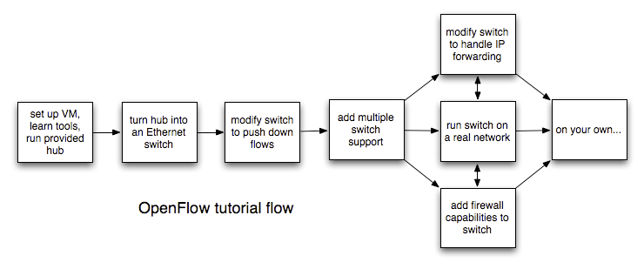
TutorialFlow

Slide 35
Stuff you’ll use
NOX
Beacon
Reference Controller/Switch
Open vSwitch
Mininet
iperf
tcpdump
Wireshark

Slide 36
Tutorial Setup
Controller
port6633
c0
loopback
(127.0.0.1:6633)
OpenFlow Tutorial
3hosts-1switch
topology
OpenFlow Switch
loopback
(127.0.0.1:6634)
dpctl
(user space process)
s1
s1-eth0
s1-eth1
s1-eth2
h1-eth0
h3-eth0
h4-eth0
h2
10.0.0.2
h3
10.0.0.3
h4
10.0.0.4
virtual hosts

Slide 37

Hands-on Tutorial
Next presentation starts at 11:00:
What can you do with OpenFlow / SDN?
Instructions still at:
www.openflow.org/wk/index.php/OpenFlow_Tutorial

Slide 38
What can you do with OpenFlow/SDN?

Slide 39
What is Software-Defined Networking (SDN)?

Slide 40
Status Quo
Closed Boxes, Fully Distributed Protocols
Closed
App
App
App
Operating
System
Specialized Packet Forwarding Hardware
App
App
App
Operating
System
App
App
App
Specialized Packet Forwarding Hardware
Operating
System
App
App
App
Specialized Packet Forwarding Hardware
Operating
System
Specialized Packet Forwarding Hardware
App
App
App
Operating
System
Specialized Packet Forwarding Hardware
40
Notes:
The next 3 slides are a set of animation to show how we enable innovation:
- Infrastructure is closed to innovation and only driven by vendors. Consumers have little say
- Business model makes it hard for new features to be added

Slide 41
“Software Defined Networking” approach to open it
App
App
App
Network Operating System
App
App
App
Operating
System
Specialized Packet Forwarding Hardware
App
App
App
Operating
System
App
App
App
Specialized Packet Forwarding Hardware
Operating
System
App
App
App
Specialized Packet Forwarding Hardware
Operating
System
Specialized Packet Forwarding Hardware
App
App
App
Operating
System
Specialized Packet Forwarding Hardware
41
Notes:
How do we redefine the architecture to open up networking infrastructure and the industry!
By bring to the networking industry what we did to the computing world

Slide 42
The “Software-defined Network”
2. At least one good operating system
Extensible, possibly open-source
3. Well-defined open API
App
App
App
Network Operating System
1. Open interface to hardware
Simple Packet Forwarding Hardware
Simple Packet Forwarding Hardware
Simple Packet Forwarding Hardware
Simple Packet Forwarding Hardware
Simple Packet Forwarding Hardware
42
Notes:
Switches, routers and other middleboxes are dumbed down
The key is to have a standardized control interface that speaks directly to hardware

Slide 43
Isolated “slices”
Many operating systems, or
Many versions
App
App
App
App
App
App
App
App
Network Operating System 1
Network Operating System 2
Network Operating System 3
Network Operating System 4
Open interface to hardware
Virtualization or “Slicing” Layer
Open interface to hardware
Simple Packet Forwarding Hardware
Simple Packet Forwarding Hardware
Simple Packet Forwarding Hardware
Simple Packet Forwarding Hardware
Simple Packet Forwarding Hardware

Slide 44
SDN examples using OpenFlow Simple primitive, but many applications
Stanford Demos
Others
Wireless mobility
VM mobility/migration
Network virtualization
Power management
Hardware
Load balancing
Traffic Engineering
Removing spanning tree
Network visualization
Network debugging
Packet-circuit convergence
Home networks
Flexible access control
Scale-out routers
Scale-out data centers

Slide 45
OpenFlow Demonstration Overview
Topic
Demo
Network Virtualization | FlowVisor
Hardware Prototyping | OpenPipes
Load Balancing | PlugNServe
Energy Savings | ElasticTree
Mobility | MobileVMs
Traffic Engineering | Aggregation
Wireless Video | OpenRoads

Slide 46
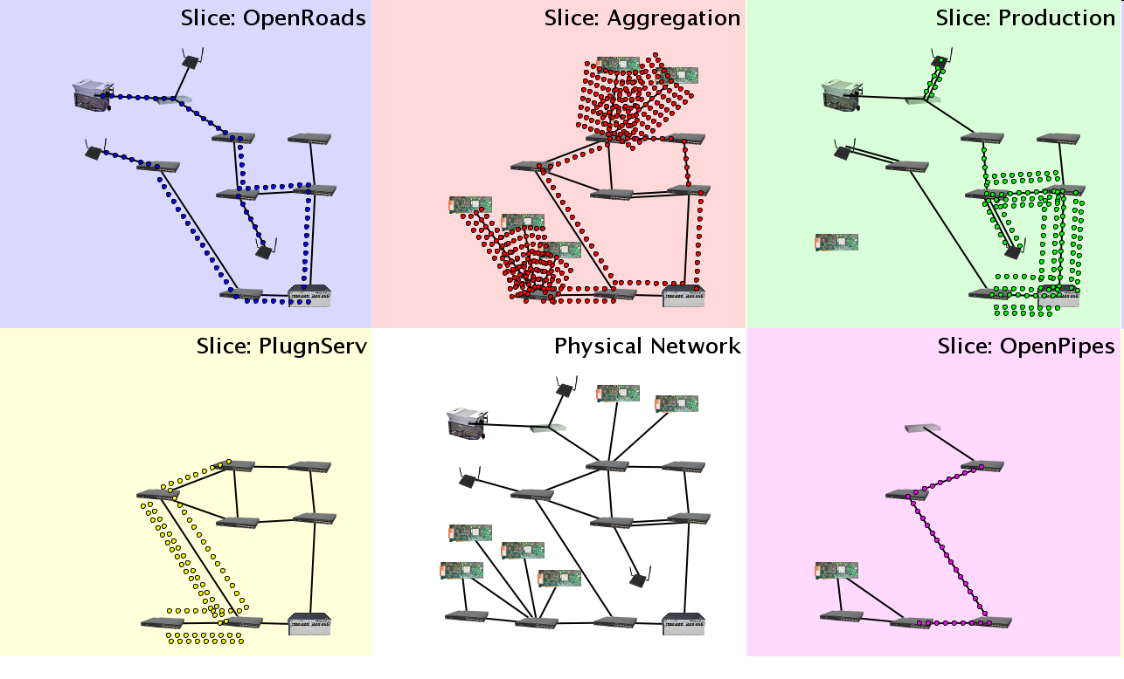
Demo Infrastructure with Slicing
WiMax
WiFi APs
OpenFlow switches
Flows
Packet processors

Slide 47



FlowVisor Creates Virtual Networks
OpenPipes
Demo
OpenRoads
Demo
PlugNServe
Load-balancer
Each demo presented here runs in an isolated slice of Stanford’s production network.
OpenFlow
Protocol
OpenFlow
Protocol
OpenFlow
Switch
FlowVisor
OpenPipes
Policy
FlowVisor slices OpenFlow networks, creating multiple isolated and programmable logical networks on the same physical topology.
OpenFlow
Switch
OpenFlow
Switch

Slide 48

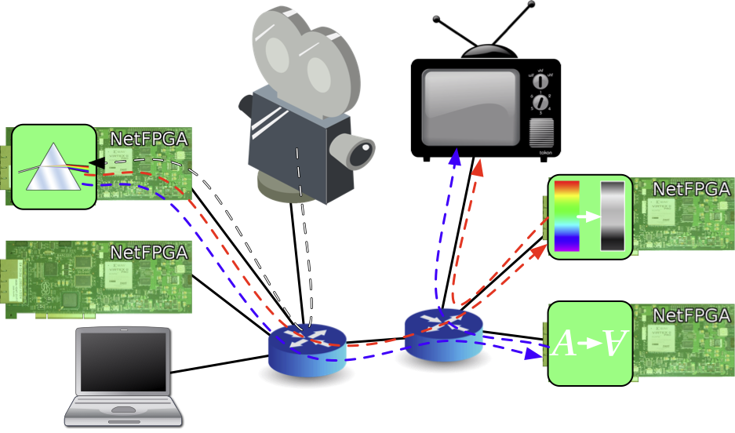
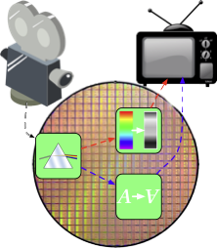

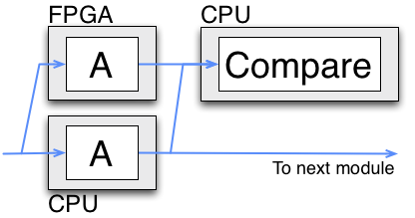
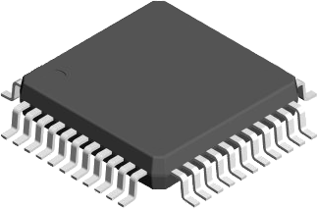
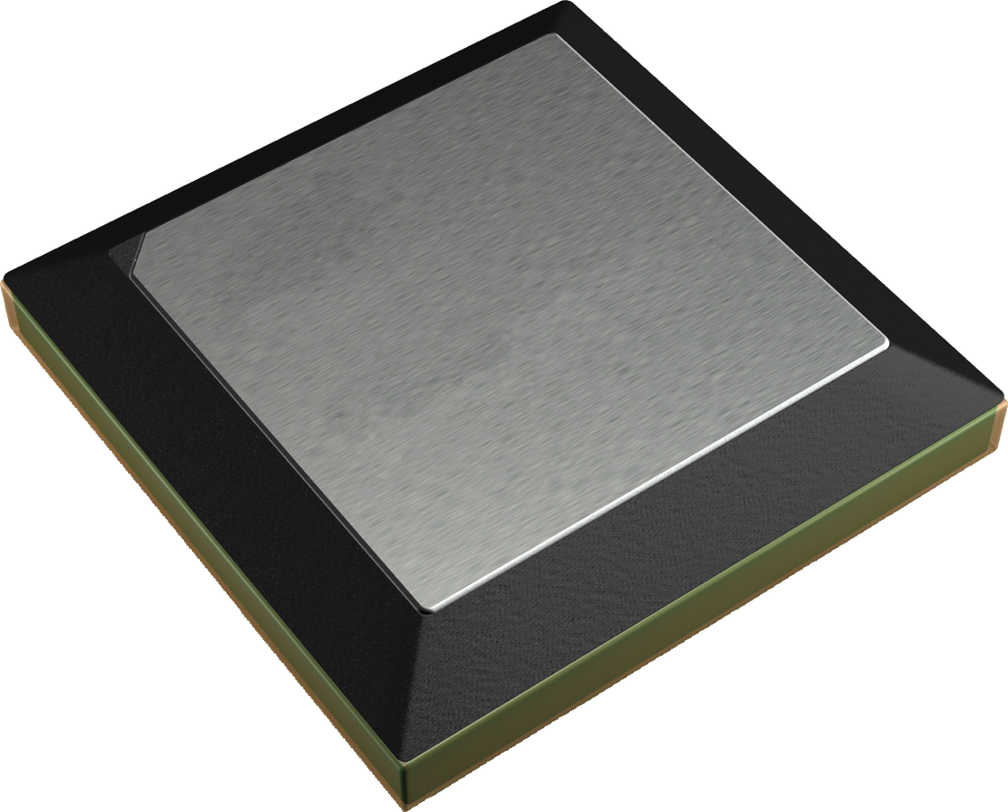
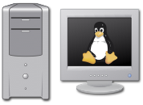
OpenPipes
Plumbing with OpenFlow to build hardware systems
Partition hardware designs
Mix resources
Test

Slide 49
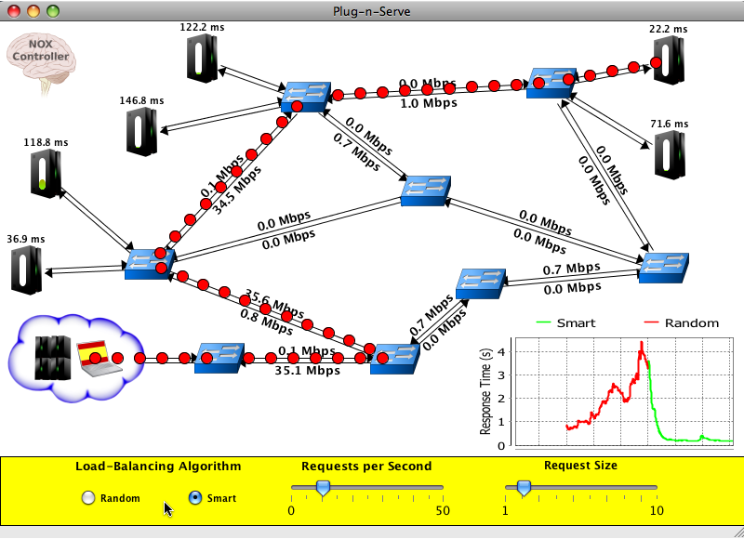
Plug-n-Serve:
Load-Balancing Web Traffic using OpenFlow
Goal: Load-balancing requests in unstructured networks
What we are showing
OpenFlow-based distributed load-balancer
Smart load-balancing based on network and server load
Allows incremental deployment of additional resources
OpenFlow means…
Complete control over traffic within the network
Visibility into network conditions
Ability to use existing commodity hardware
This demo runs on top of the FlowVisor, sharing the same physical network with other experiments and production traffic.

Slide 50
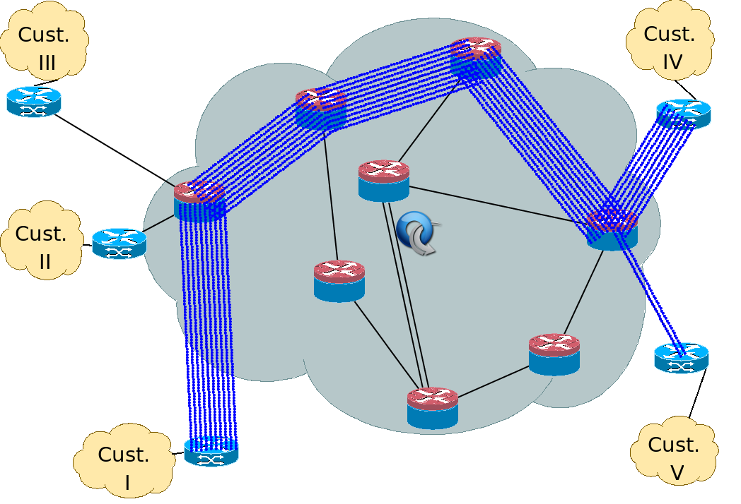
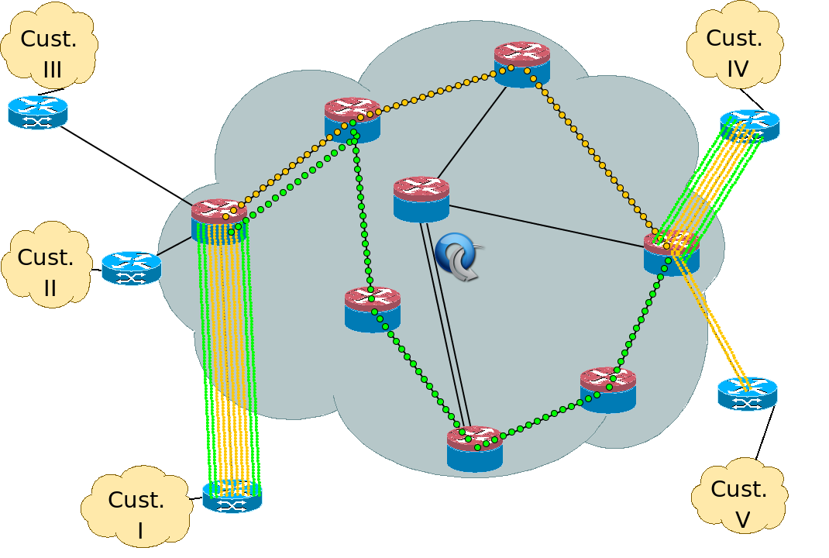
Dynamic Flow Aggregation on an OpenFlow Network
Scope
Different Networks want different flow granularity (ISP, Backbone,…)
Switch resources are limited (flow entries, memory)
Network management is hard
Current Solutions : MPLS, IP aggregation
How OpenFlow Helps?
Dynamically define flow granularity by wildcarding arbitrary header fields
Granularity is on the switch flow entries, no packet rewrite or encapsulation
Create meaningful bundles and manage them using your own software (reroute, monitor)
Higher Flexibility, Better Control, Easier Management, Experimentation

Slide 51
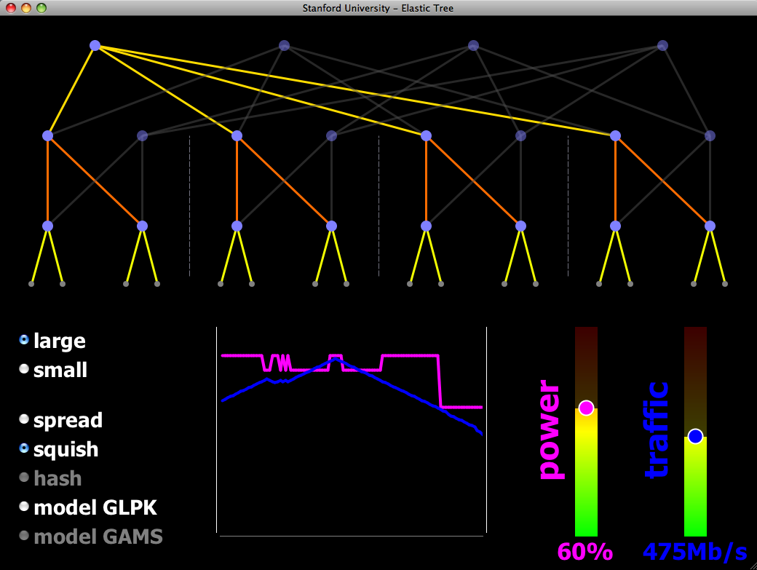
ElasticTree: Reducing Energy in Data Center Networks
Shuts off links and switches to reduce data center power
Choice of optimizers to balance power, fault tolerance, and BW
OpenFlow provides network routes and port statistics
The demo:
Hardware-based 16-node Fat Tree
Your choice of traffic pattern, bandwidth, optimization strategy
Graph shows live power and latency variation
demo credits: Brandon Heller, Srini Seetharaman, Yiannis Yiakoumis, David Underhill

Slide 52
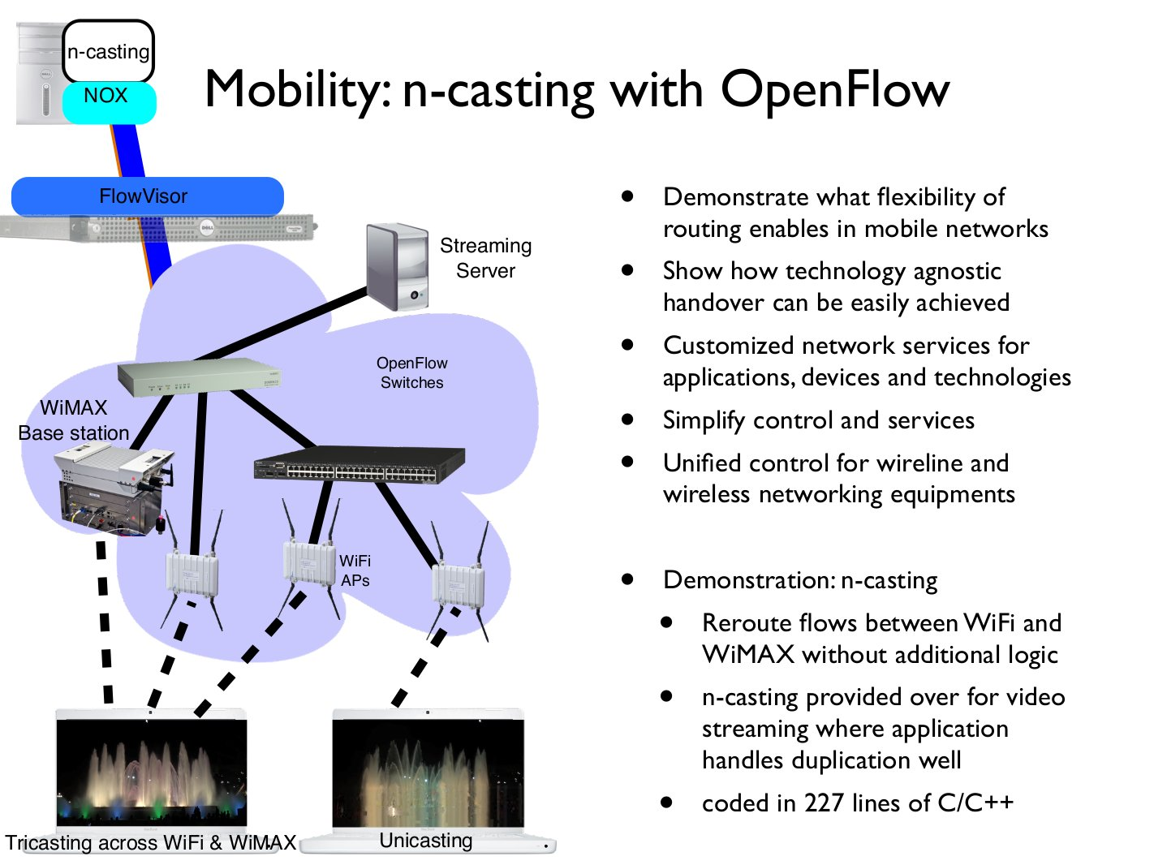

Slide 53
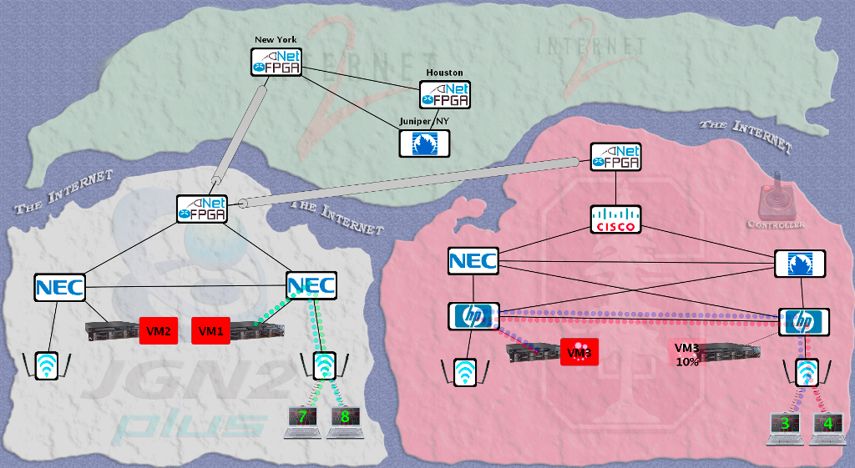
Intercontinental VM Migration
Moved a VM from Stanford to Japan without changing its IP.
VM hosted a video game server with active network connections.

Slide 54
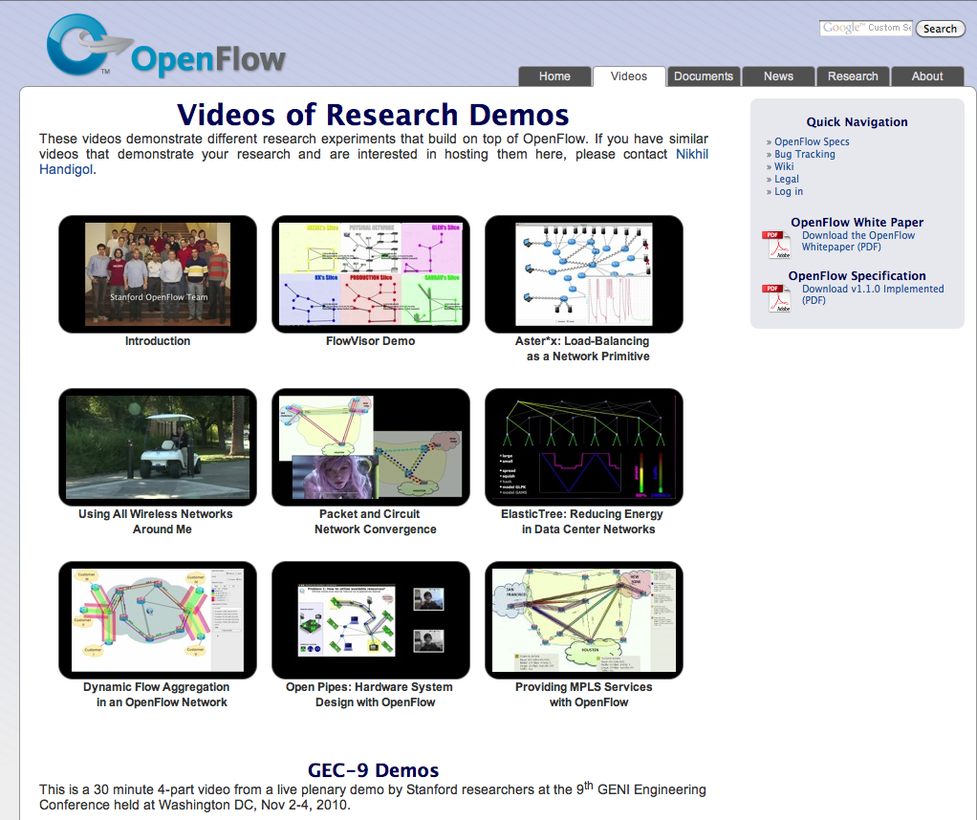
openflow.org/videos

Slide 55
Video Time

Slide 56
Hands-on Tutorial
Next presentation starts at 1:30
SDN Building Blocks
Instructions still at:
www.openflow.org/wk/index.php/OpenFlow_Tutorial

Slide 57
SDN Building Blocks

Slide 58
OpenFlow building blocks
oftrace
oflops
openseer
Monitoring/ debugging tools
Stanford Provided
ENVI (GUI)
LAVI
n-Casting
Expedient
Applications
NOX
Beacon
Trema
Maestro
ONIX
Controller
Slicing
Software
FlowVisor
Console
FlowVisor
Commercial Switches
Stanford Provided
Software
Ref. Switch
NetFPGA
Broadcom
Ref. Switch
HP, NEC, Pronto, Juniper.. and many more
OpenFlow
Switches
OpenWRT
PCEngine WiFi AP
Open vSwitch
58
Notes:
There are components at different levels that work together in making it work
The commercial switch details will follow in next slide
There are a plethora of applications possible. I only list those available at Stanford

Slide 59
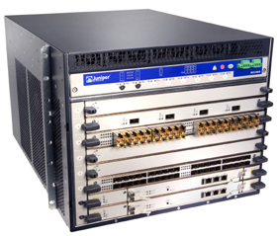
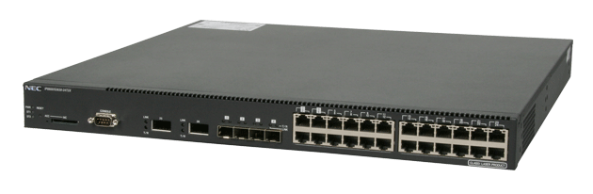
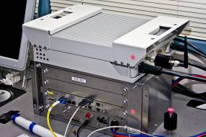
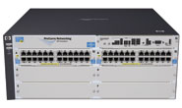
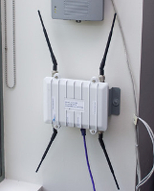
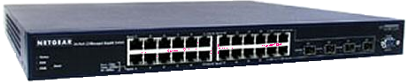
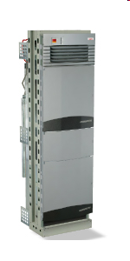

Current SDN hardware
Juniper MX-series
NEC IP8800
WiMax (NEC)
HP Procurve 5400
Netgear 7324
PC Engines
Pronto 3240/3290
Ciena Coredirector
Ask your vendors
59

Slide 60
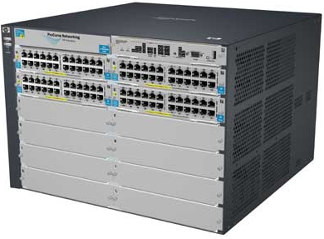
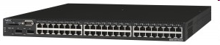
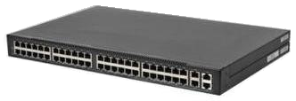
Commercial Switch Vendors
Model | Virtualize | Notes
HP Procurve 5400zl or 6600 | 1 OF instance per VLAN | LACP, VLAN and STP processing before OpenFlow Wildcard rules or non-IP pkts processed in s/w Header rewriting in s/w CPU protects mgmt during loop
NEC IP8800 | 1 OF instance per VLAN | OpenFlow takes precedence Most actions processed in hardware MAC header rewriting in h/w
Pronto 3240 or 3290 with Pica8 or Indigo firmware | 1 OF instance per switch | No legacy protocols (like VLAN and STP) Most actions processed in hardware MAC header rewriting in h/w
60
Notes:
All support ver 1.0
All have approx 1500 flow table entry limit

Slide 61
Open Controllers
Name | Lang | Platform(s) | License | Original Author | Notes
OpenFlow Reference | C | Linux | OpenFlow License | Stanford/Nicira | not designed for extensibility
NOX | Python, C++ | Linux | GPL | Nicira | actively developed
Beacon | Java | Win, Mac, Linux, Android | GPL (core), FOSS Licenses for your code | David Erickson (Stanford) | runtime modular, web UI framework, regression test framework
Maestro | Java | Win, Mac, Linux | LGPL | Zheng Cai (Rice)
Trema | Ruby, C | Linux | GPL | NEC | includes emulator, regression test framework
RouteFlow | ? | Linux | Apache | CPqD (Brazil) | virtual IP routing as a service
Notes:
Language open-source Performance cross-platform runtime modular

Slide 62
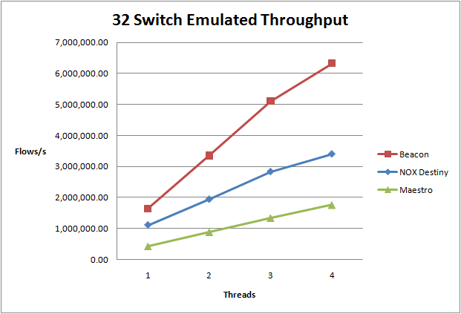
all 1M plus flows in one box!
CPU: 1 x Intel Core i7 930 @ 3.33ghz, 9GB RAM, Ubuntu 10.04.1 x64
For more testing details, see:
http://www.openflow.org/wk/index.php/Controller_Performance_Comparisons
Notes:
Cbench Test, part of Oflops suite
PacketIn to PacketOut/FlowMod throughput test, fills controller input buffers
10 loops, 32 switches, 10s per loop
Test Machine
CPU: 1 x Intel Core i7 930 @ 3.33ghz, 9GB RAM, Ubuntu 10.04.1 x64
Controllers
Beacon, NOX (Destiny branch), Maestro

Slide 63
Closed-source Controller Vendors
Ask these vendors for more info
BigSwitch
Nicira
NEC

Slide 64

























Growing Community
Vendors and start-ups
Providers and business-unit
More...
More...
Note: Level of interest varies
64

Slide 65
Related Research
DIFANE
Rule partitioning for controller-less flow insertion
UCSD Fat Tree Series: Scalable Commodity Data Center, PortLand, Hedera
Scale-out data centers that use OpenFlow
Tesseract
Centralized WAN in the 4D Architecture
ONIX
Fault-tolerant controller platform from Nicira, Google, NEC
DevoFlow
Practical scalability limits to OpenFlow and modifications to get around them

Slide 66
Virtualizing OpenFlow
66

Slide 67
Trend
App
App
App
App
App
App
Controller 1
Controller
2
Windows
(OS)
Linux
Mac
OS
Controller 1
Controller
2
Windows
(OS)
Linux
Mac
OS
NOX
(Network OS)
Network OS
Windows
(OS)
Linux
Mac
OS
Virtualization layer
Virtualization or “Slicing”
x86
(Computer)
OpenFlow
Computer Industry
Network Industry
Notes:
Hidden slide (just for backup reasons)
Shows how far along we can go in opening up the network
67

Slide 68
Isolated “slices”
Many operating systems, or
Many versions
App
App
App
App
App
App
App
App
Network Operating System 1
Network Operating System 2
Network Operating System 3
Network Operating System 4
Open interface to hardware
Virtualization or “Slicing” Layer
Open interface to hardware
Simple Packet Forwarding Hardware
Simple Packet Forwarding Hardware
Simple Packet Forwarding Hardware
Simple Packet Forwarding Hardware
Simple Packet Forwarding Hardware

Slide 69

Switch Based Virtualization Exists for NEC, HP switches but not flexible enough
Research VLAN 2
Flow Table
Controller
Research VLAN 1
Flow Table
Controller
Production VLANs
Normal L2/L3 Processing
Notes:
Experiments running on PRODUCTION infrastructure
Key to get scale, key to get traffic on the network
(e.g. can’t just do a reset...)

Slide 70
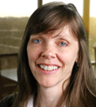
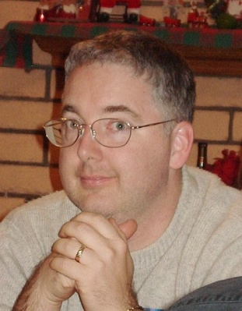
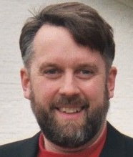
FlowVisor-based Virtualization
Heidi’s
Controller
Craig’s
Controller
Aaron’s
Controller
Topology discovery is per slice
OpenFlow
Protocol
OpenFlow
Switch
OpenFlow FlowVisor & Policy Control
OpenFlow
Protocol
OpenFlow
Switch
OpenFlow
Switch
70

Slide 71
FlowVisor-based Virtualization
http
Load-balancer
Broadcast
Multicast
Separation not only
by VLANs, but any
L1-L4 pattern
dl_dst=FFFFFFFFFFFF
OpenFlow
Protocol
tp_src=80, or tp_dst=80
OpenFlow
Switch
OpenFlow
FlowVisor & Policy Control
OpenFlow
Protocol
OpenFlow
Switch
OpenFlow
Switch

Slide 72
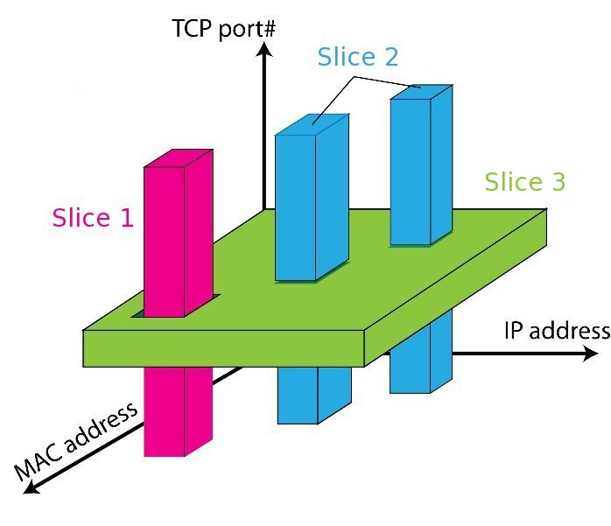
FlowSpace: Maps Packets to Slices

Slide 73
FlowVisor Message Handling
Alice
Controller
Bob
Controller
Cathy
Controller
Rule
OpenFlow
Policy Check:
Is this rule allowed?
Policy Check:
Who controls this packet?
FlowVisor
OpenFlow
Full Line Rate
Forwarding
OpenFlow
Firmware
Exception
Packet
Data Path
Packet

Slide 74
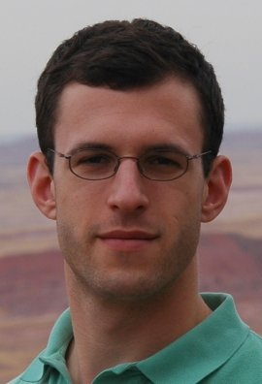
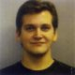
Use Case: New CDN - Turbo Coral ++
Basic Idea: Build a CDN where you control the entire network
All traffic to or from Coral IP space controlled by Experimenter
All other traffic controlled by default routing
Topology is entire network
End hosts are automatically added (no opt-in)
Switch
Port
MAC
src
MAC
dst
Eth
type
VLAN
ID
IP
Src
IP
Dst
IP
Prot
TCP
sport
TCP
dport
*
*
*
*
*
84.65.*
*
*
*
*
*
*
*
*
*
*
84.65.*
*
*
*
*
*
*
*
*
*
*
*
*
*

Slide 75
Use Case: Aaron’s IP
A new layer 3 protocol
Replaces IP
Defined by a new Ether Type
Switch
Port
MAC
src
MAC
dst
Eth
type
VLAN
ID
IP
Src
IP
Dst
IP
Prot
TCP
sport
TCP
dport
*
*
*
AaIP
*
*
*
*
*
*
*
*
*
!AaIP
*
*
*
*
*
*

Slide 76
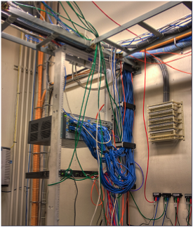
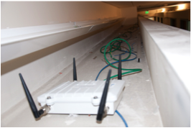
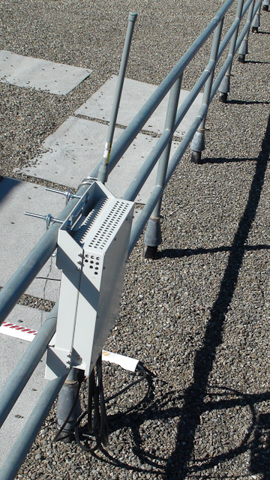
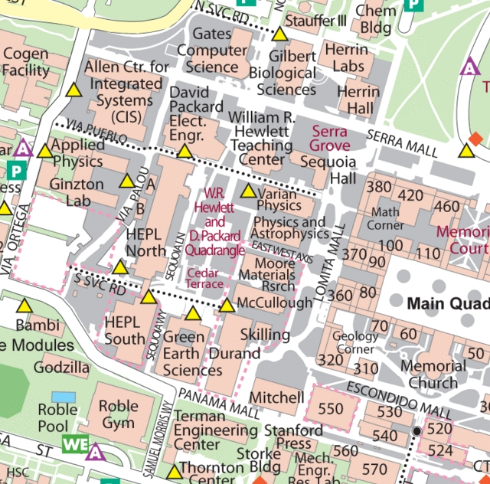
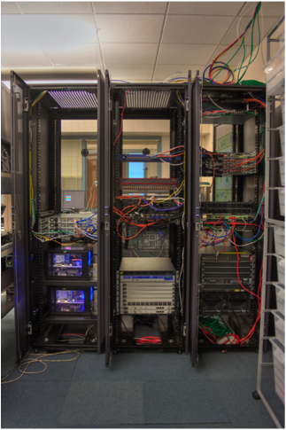
OpenFlow Deployment at Stanford
Switches (23)
APs (50)
WiMax (1)

Slide 77
Live Stanford Deployment Statistics
http://yuba.stanford.edu/ofhallway/wide-ofv1.html

Slide 78
How did we get there?
Staged Deployment of OpenFlow
Add experimental VLAN
Enable OpenFlow for Exptl VLAN
Configure Controller for new network
Add new Production subnetwork
Gradually add/move users to new subnet
Enable OpenFlow for new subnet
Slice the network
Verify correctness and performance
Verify reachability

Slide 79
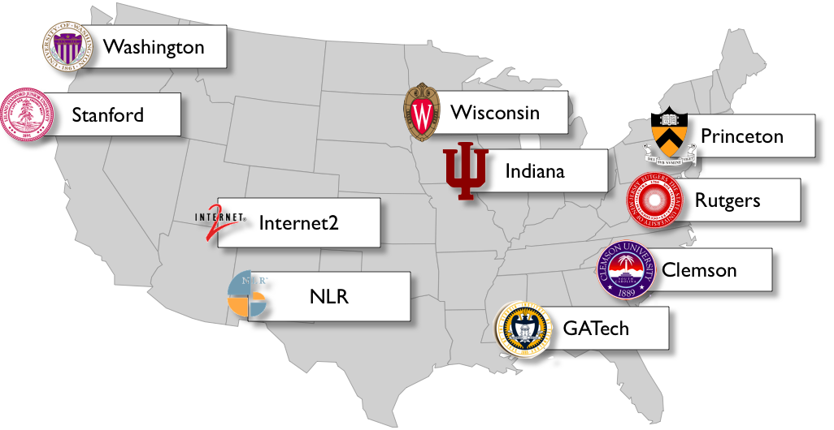


GENI OpenFlow deployment (2010)
10 institutions and 2 National Research Backbones
Kansas State

Slide 80
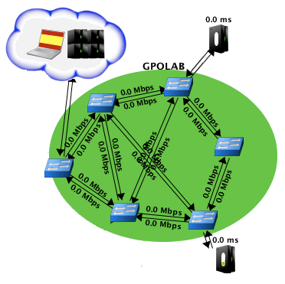
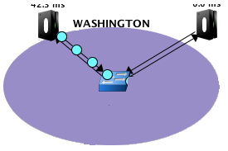


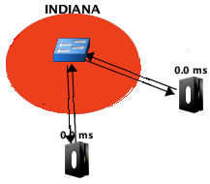

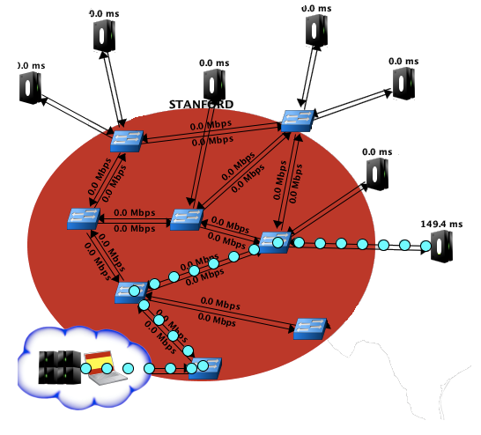
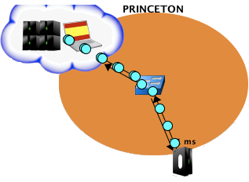


GENI Network Evolution
National Lambda Rail

Slide 81
GENI Integration
FlowVisor
Slicing control
Expedient
Experimenter’s portal for slice management
Opt-in Manager
Network admins’ portal to approve/ deny expt requests for traffic
Expedient3
GENI API
API X
Expedient1
Expedient2
API X
API X
Opt-in Mgr1
Opt-in Mgr2
FlowVisor API
FlowVisor API
FlowVisor1
FlowVisor2
OpenFlow
OpenFlow
Substrate 1
Substrate 2

Slide 82
Mistakes we made
OpenFlow over Q-in-Q
OpenFlow routing is unaware and sends traffic with same MAC address in both direction, causing perpetual learning and CPU inflation
Moving uplinks for 1 switch, while being pointed to the same controller (causing two islands)
Causes controller learning to oscillate between the 2 uplinks
Bad interaction with legacy protocols
LLDP and STP are treated differently with different switches
Loop in OpenFlow network being exposed to non-OF side
Miscommunication between the aggregate operator and the experimenter during testing phase
Loop across backbones
Same campus connected over NLR and Internet2

Slide 83
Next steps for GENI
Remove duct-tape
Fix any issues that we learned about during demos
Be better prepared
Higher stability and better isolation
Test bandwidth slicing
Grow topology
Add more switches and hosts
Wean off
Each campus takes charge of control framework
Notes:
33 bugs to be fixed in FlowVisor

Slide 84
Tutorial Setup so far
Controller
port6633
c0
loopback
(127.0.0.1:6633)
OpenFlow Tutorial
3hosts-1switch
topology
OpenFlow Switch
loopback
(127.0.0.1:6634)
dpctl
(user space process)
s1
s1-eth0
s1-eth1
s1-eth2
h1-eth0
h3-eth0
h4-eth0
h2
10.0.0.2
h3
10.0.0.3
h4
10.0.0.4
virtual hosts
84

Slide 85
Virtualized Network Setup
Controller
port 7000
loopback
(127.0.0.1:7000)
c0
FlowVisor
port 6633
OpenFlow Tutorial
3hosts-1switch
topology
loopback
(127.0.0.1:6634)
OpenFlow Switch
loopback
(127.0.0.1:6634)
dpctl
(user space process)
s1
s1-eth0
s1-eth1
s1-eth2
h1-eth0
h3-eth0
h4-eth0
h2
10.0.0.2
h3
10.0.0.3
h4
10.0.0.4
virtual hosts
85

Slide 86
FlowVisor Usage
man ./doc/flowvisor.8
<flowvisor dir>/script/fvctl.sh
listDevices
list of all OpenFlow switches’ datapath ID
getLinks
list of all links (port # and datapath ID of both end switches)
createSlice
creating slice (specifying controller’s URL and slice name)
listSlices
addFlowSpace
add flow space to slices
listFlowSpace
show current flow space
86

Slide 87
Highlights of Deployments
Stanford deployment
McKeown group for 1.5 years: production and experiments
To scale later this year to entire building (~500 users)
Nation-wide trials and deployments
7 other universities and BBN deploying now
GEC9 in Nov, 2010 showcased nation-wide OF
Internet 2 and NLR starting to serve as the GENI Backbone
Global trials
Over 60 organizations experimenting
2011 likely to be a big year for OpenFlow

Slide 88
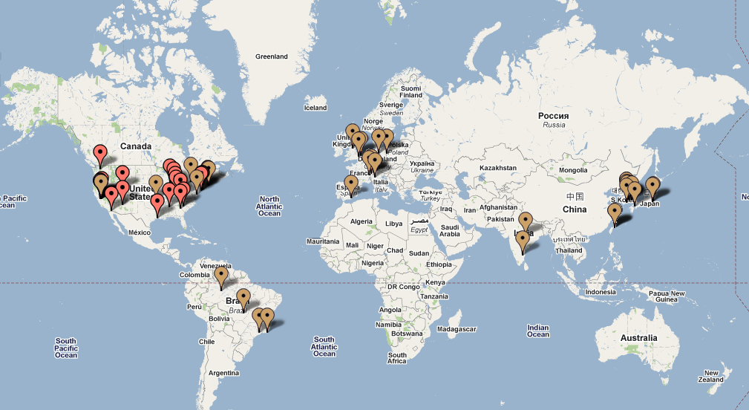
Current Trials
68 trials/deployments spanning 13 countries

Slide 89
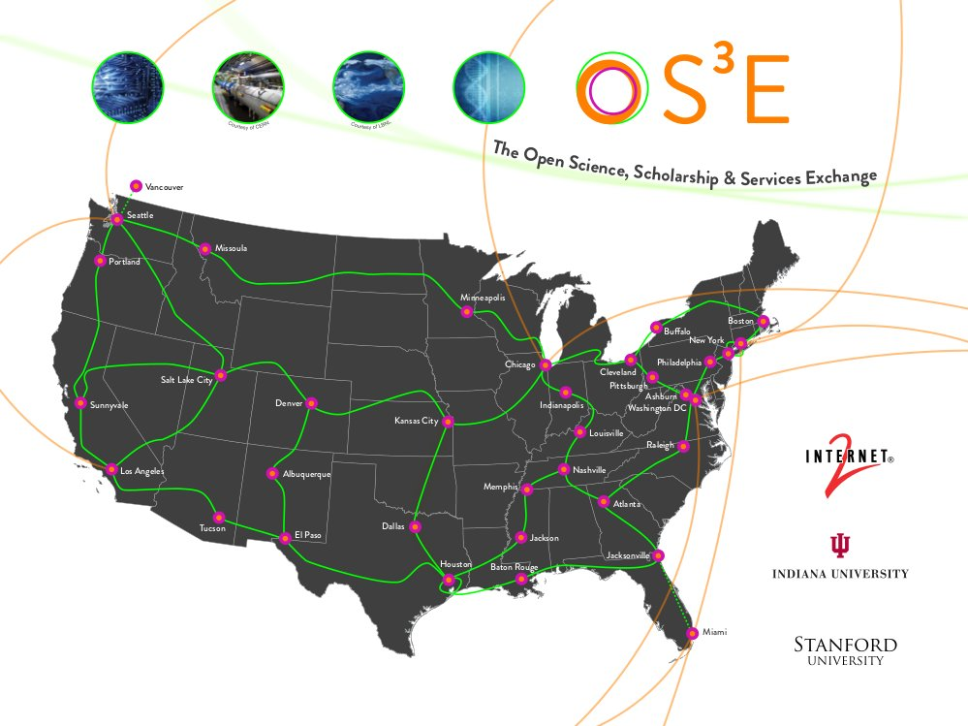
Internet2 OpenFlow deployment initiative. 35+ 100G POPs, nationwide.

Slide 90
Hands-on Tutorial
Next presentation starts at 2:45
SDN Deployment Forum
Instructions still at:
www.openflow.org/wk/index.php/OpenFlow_Tutorial

Slide 91
SDN Deployment Forum

Slide 92
Our speakers
Johan van Reijendam (Stanford)
David Erickson (Stanford)
Subhasree Mandal (Google)

Slide 93
Questions
What was your hardest/funniest error to debug?
What’s your one strongest gripe about OpenFlow?
Do you have a simple example of something that your network does better now?

Slide 94
Closing

Slide 95
Closing Thoughts
OpenFlow is a protocol
How to use it is up to you
Software-Defined Networking is an architecture
Of which OpenFlow is just a piece
OpenFlow is available, used, and improving
These are the early stages for OF, ONS, and SDN
Notes:
In a sense, solving the hardest piece: have to get agreement between 100’s of vendors with different requirements and motivations.
In another sense, solving the easiest piece: doesn’t do much and doesn’t consider consistency or other distributed systems problems.
Early stages: plenty of time to get involved and contribute a new piece.

Slide 96
Get involved!
Ask and answer questions on mailing lists:
openflow-discuss
openflow-spec
Join and participate Open Networking Forum
Share and update wiki content
Submit bug-reports and/or patches to OF reference implementation and Open vSwitch
Release open-source applications
Write a controller!

Slide 97
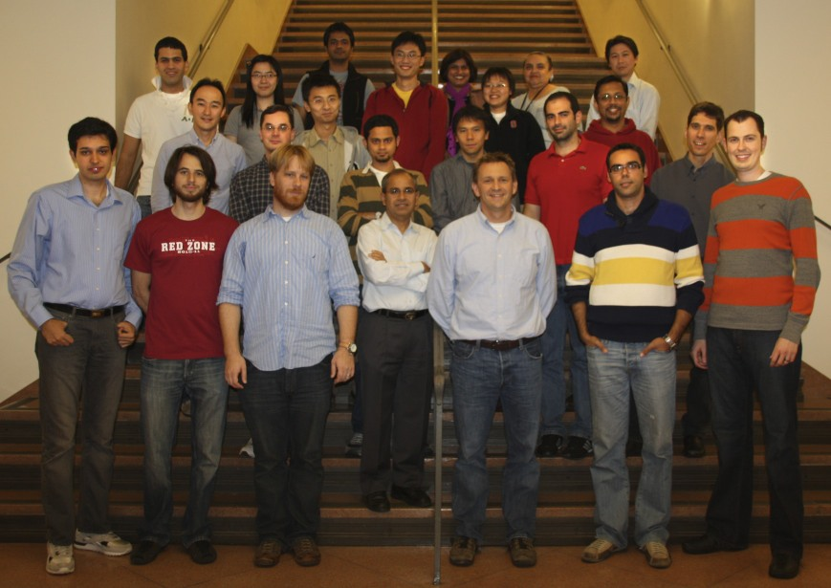
SDN Team at Stanford
Thanks!

